Slide 1
Connection Established
Raspberry Pi Project, by Jhonatan

Slide 2

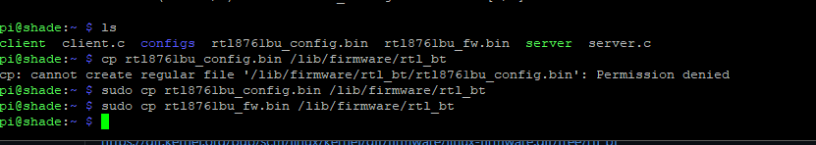
Environment Set Up
Download the shell script using
wget https://raw.githubusercontent.com/joshuar49/EvilSmurf2/main/DBD%20Code/Raspberry%20Project/pi.sh
And run it using . pi.sh
Update, reboot, move/copy files, disable onboard bluetooth

Slide 3
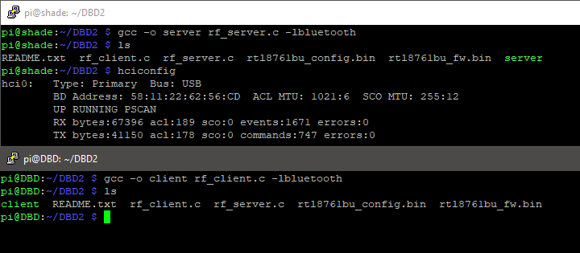
File Compilation and Terminal Set up
Obtain MAC address from server dongle
Hard code into client.c file
Compile client and server files in respective devices

Slide 4
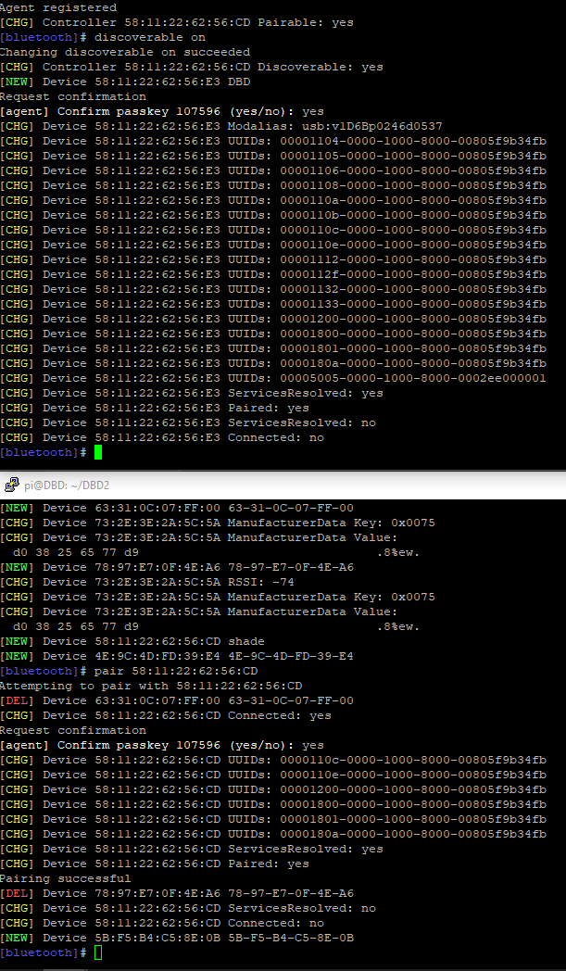
Bluetoothctl Connection
Start sudo Bluetoothctl on both devices
Make the server discoverable
Once found by the client, connect to the server with
Pair MAC:ADDRESS

Slide 5
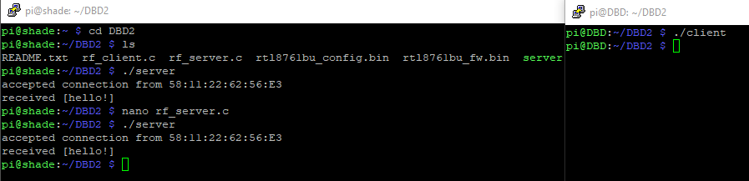
Program Execution
Run server first, then client

Slide 6
Future Directions
VM Bluetooth connections via bluez or bluetoothctl
Further understanding of C code Bluetooth programing for a DOS attack via Bluetooth connections by the raspberry pi’s
Better forms of documentation and recreating

